Slide 1
One hidden layer
Neural Network
Derivatives of
activation functions
Notes:
Why do we need to calculate the slope or the derivative of activation function. For example, in logistic regression the activation function was sigmoid whose value was a. & to calculate bakpropagation overall we need to derive the slope of this function as well.

Slide 2
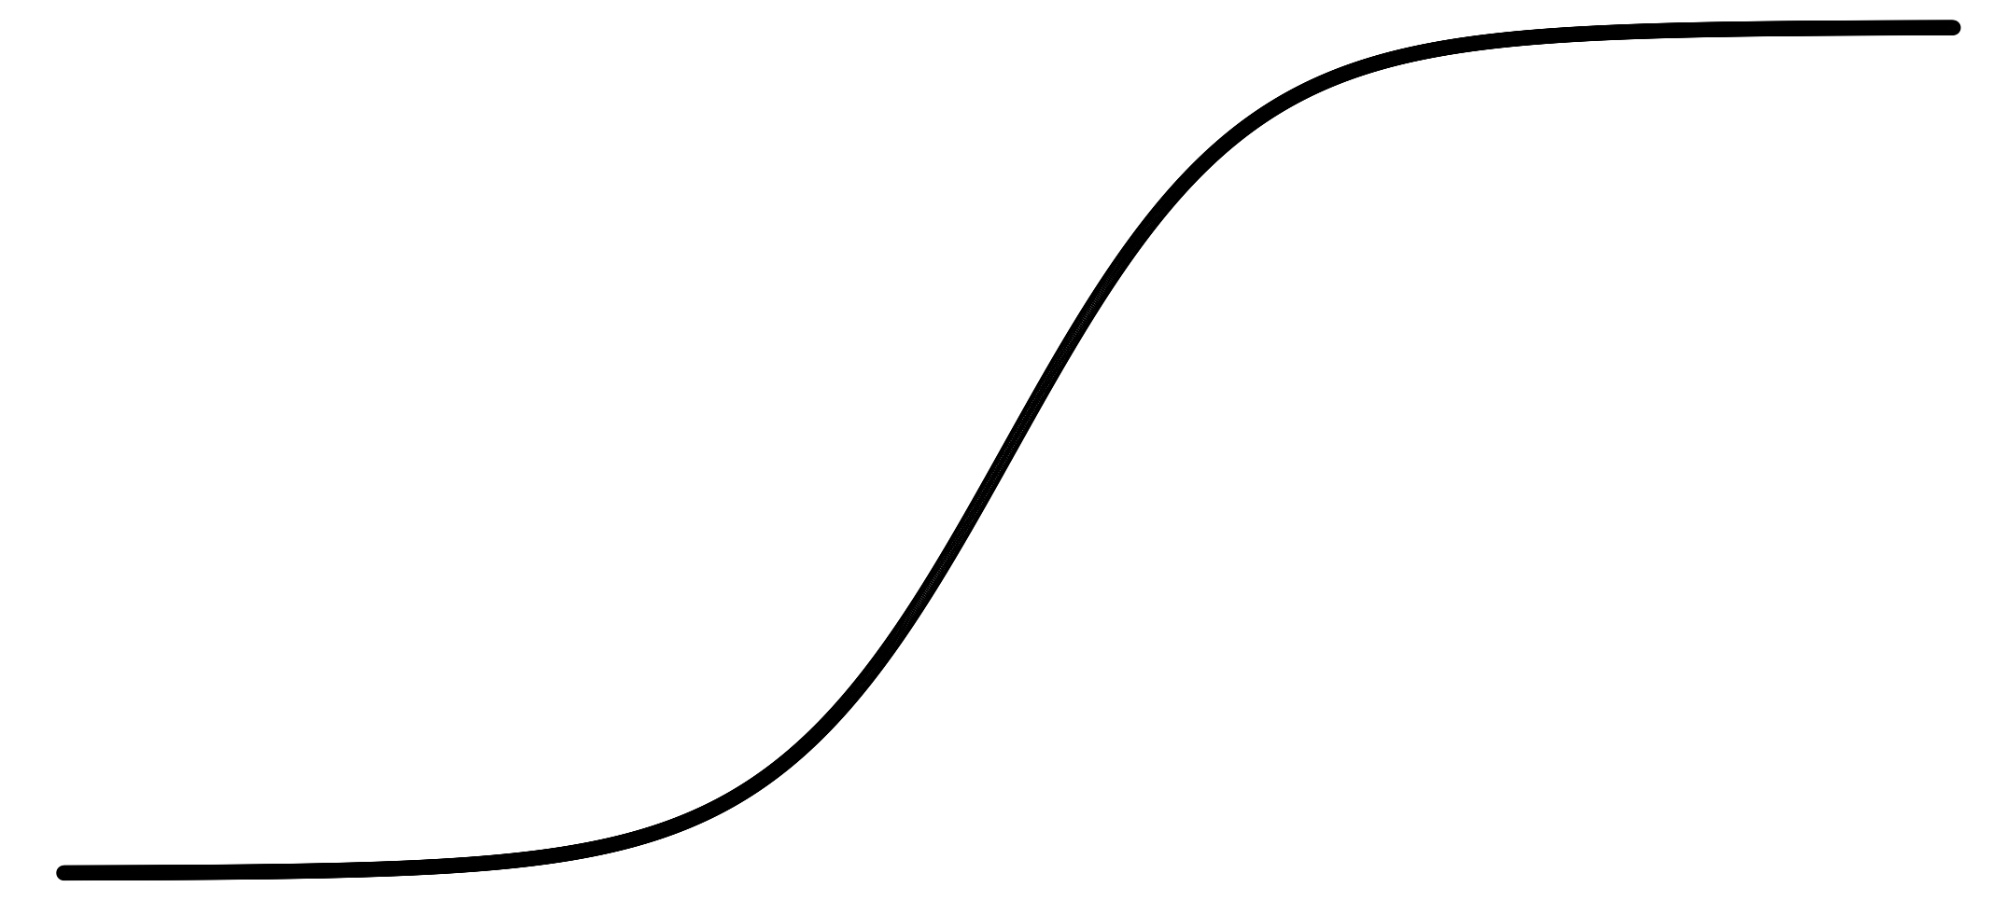
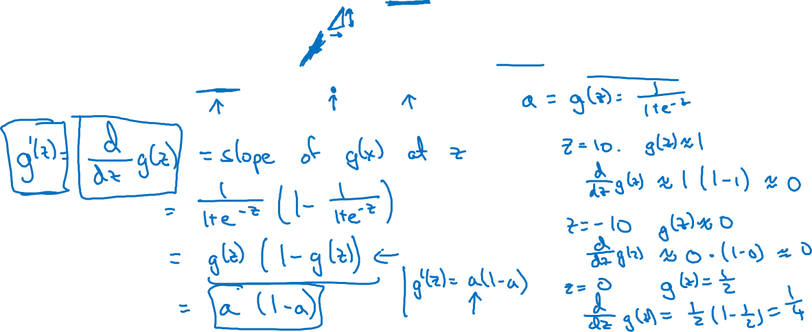
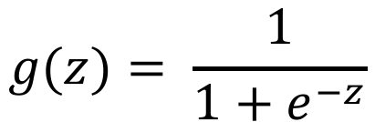
Sigmoid activation function
a
$$g(z)= \frac{1}{1+e^{−z}}$$
z
Notes:
Question: What are we doing & what are we doing ?
Answer: When we are computing back propagation, we need to compute the slope or derivatives. In this slide, we are focusing on, sigmoid function activation.
Let us understand here what is going on in the above diagram:
To calculate the derivative of sigmoid function, we use the formula which gets us the derivative & from this we get a(1-a)
The right section of the slide tells us how does this formula works.
Now remember that, sigmoid function produces values between 0 & 1.
When X value is large, lets say 10, than the value of sigmoid of z will be 1. sig(z) is termed as a.
The derivative in that case will be a(1-a), if we put in values we get 1(0) = 0 which makes sense as well. The reason is that when the value is very high its slope line is more or less constant.
Similarly, when z value is small than g(z) will be 0, its derivative will be a(1-a) which will be 0.(1-0). This will again turn it 0, this too shows that when z value is smaller the slop is more or less constant.
Where as in the middle, when z value is 0, g(z) is about ½ putting it in the formula will get us a(1-a) = ½(1-1/2) = ¼ which is actually the slope at the middle.
Notation in implementation sometimes:
G prime of z is short hand for derivative of the function g wrt to z.

Slide 3
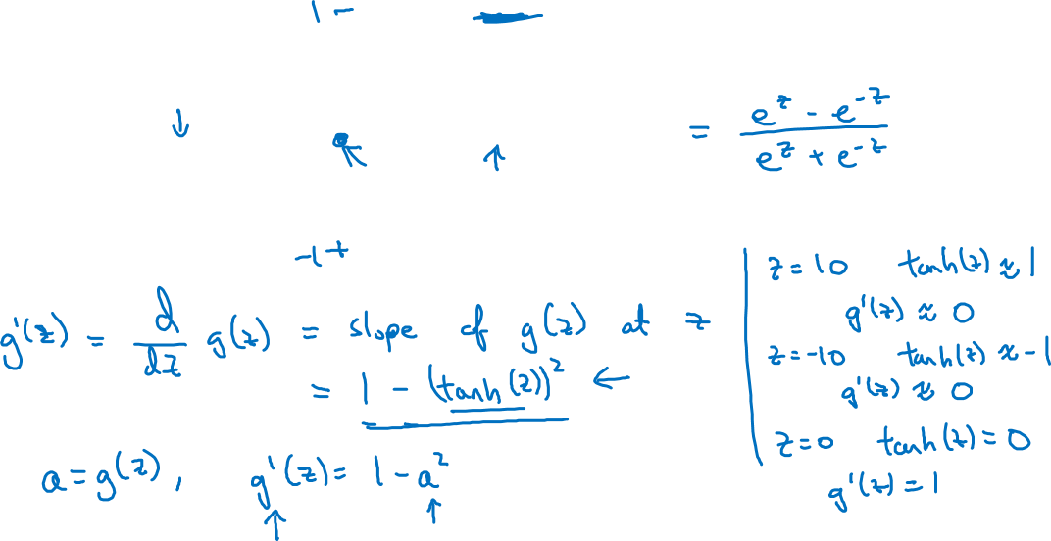

Tanh activation function
a
$$g(z)=tanh(z){ }$$
z
Notes:
Slope at a particular z value
We have the formula of tanh derivative from calculus.
We can develop sanity check as shown in the right side.
Case 1- when Z is large
Tanh value will be 1 & using the formula 1 – tanh2 the derivative or slope value will be 0 which is shown.
Case 2 when z is small
Tanh value will be -1 & using the derivative formula slope will be 1 – (-1) square which becomes 0 again
Case 3 when z is 0
Tanh value will be 0 & the slope value will be 1.

Slide 4
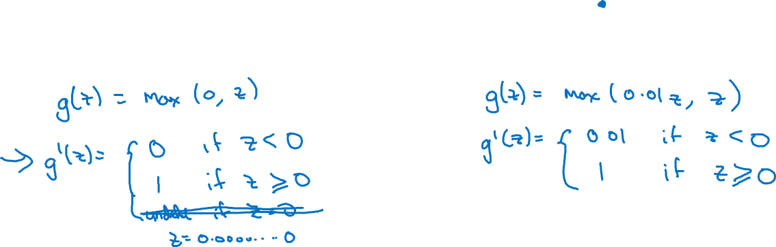
ReLU and Leaky ReLU
a
a
z
z
ReLU
Leaky ReLU
Notes:
ReLu
When z is exactly 0 derivative of g of z is undefined but it works fine because the change of z being exactly 0 is very small. However rn practice it works.
Same is the case for Relu.

